Slide 1
DATA-SCIENCE

Slide 2
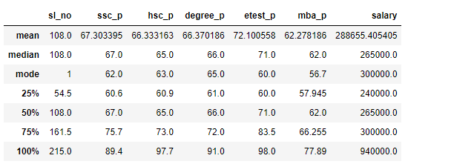

Slide 3
MEAN:
Total mean value of the ssc_p students 67 ,so all the students are getting average markes in 10th std
Total mean value of the hsc_p students 65 ,so all the students are getting average markes in 12th std
Total mean value of the degree_p students 66,so all the students are getting average markes studing in degree
Total mean value of the etest_p students 71 ,so all the students are getting good markes in enterance exam
Total mean value of the mba_p students 61 ,so all the students are getting average markes studing in MBA
These students are getting averag salary of RS 405405

Slide 4
MEDIAN
Median valuse is like same to the mean . median value calculation used for outerline value
Median value of the ssc_p students 62 ,so all the students are getting average markes in 10th std
Median value of the hsc_p students 63 ,so all the students are getting average markes in 12th std
Median value of the degree_p students 65,so all the students are getting average markes studing in degree
Median value of the etest_p students 60 ,so all the students are getting average markes in enterance exam
Median value of the mba_p students 56 ,so all the students are getting average markes studing in MBA
These students are getting averag salary of RS 265000

Slide 5
MODE
In ssc-p many studens were got 62 marks
In hsc-p many studens were got 63 marks
In degree-p many studens were got 65 marks
In etest-p many studens were got 60 marks
In mba-p many studens were got 57 marks
Many students were getting 300000salary

Slide 6
percentile
In ssc_p 25% students are got below 60.6 marks
In hsc_p 25% students are got below 60.9 marks
In degree_p 25% students are got below 61. marks
In etest_p 25% students are got below 60 marks
In mba_p 25% students are got below 57.9 marks
25% students are getting salary of 240000

Slide 7
In ssc_p 50% students are got below 67 marks
In hsc_p 50% students are got below 65 marks
In degree_p 50% students are got below 66. marks
In etest_p 50% students are got below 71 marks
In mba_p 50% students are got below 62 marks
50% students are getting salary of 265000

Slide 8
In ssc_p 75% students are got below 73marks
In hsc_p 75% students are got below 73 marks
In degree_p 75% students are got below72 marks
In etest_p 75% students are got below 83 marks
In mba_p 75% students are got below 66marks
75% students are getting salary of 300000

Slide 9
In ssc_p 100% students are got below 89marks
In hsc_p 100% students are got below 97marks
In degree_p 100% students are got below 91marks
In etest_p 100% students are got below 97 marks
In mba_p 100% students are got below 77 marks
Maximum students are getting salary of 940000

